Slide 1
TRAFFIC MANAGEMENT
PHASE – 5
SUBMITTED BY:
M.Evangelin
R.Kaviya
B.Sneha
G.Subalakshmi

Slide 2
ABSTRACT
Over the years, there has been a sudden increases in the number of vehicles on the road.Traffic congestion is a growing problem everyone faces in their daily life.
A model to effectively solve the above by using internet of things (IOT) is proposed.

Slide 3
INTRODUCTION:
HYPOTHESIS:
A smart traffic management system utilizing sensor data, communication and auto-mated algorithms is to be developed to keep traffic flowing more smoothly.

Slide 4
MOTIVATION:
In 2014,54% of the total global population was urban residents,the prediction was a growth of nearly 2% each year until 2020 leading to the more pressure on the transportation system of cities.

Slide 5
Project objectives:
Improve traffic flow
Increase safety
Reduce environment impact
Optimize infrastructure
Enhance public
Provide real-time
Support emergency service
Public engagement and education

Slide 6
IOT SENSOR SETUP
Sensor deployment
Data collection
Data processing
Traffic management
Communication and alerts
Environmental monitoring
Integration with smart system
Data storage and analysis
Cost and efficiency benefits.

Slide 7
MOBILE APP DEVELOPMENT:
Developing a traffic management project mobile app involves creating a software application that assists in manage and optimizing traffic flow, safety, and information for users.

Slide 8
USER INTERFACE(UI):
The app should have an intuitive and user-friendly interface for easy navigation.
It should include maps, icons, and menus for various functions.

Slide 9
GPS INTEGRATION
Utilize GPS to provide users with their current location,turn-by-navigation ,and real time traffic updates.
User should also be able to plan routes based on traffic conditions.

Slide 10
SECURITY
Ensure data security and privacy for users and traffic authorities , especially when collecting and sharing sensitive information.

Slide 11
SCALABILITY
Design the app to handle a large user base and the potential for increased data traffic during peak times.

Slide 12
CODE IMPLEMENTATION
Implementing a traffic management project using python involves various components , including data collection , and control.
A high –level overview of the steps and components you might consider:

Slide 13
Data collection
Data processing
Data analysis
Visualization
Machine learning
Traffic control
User interface

Slide 14
Communication
Alerting system
Testing and simulation
Deployment
Maintenance and Monitoring

Slide 15
PYTHON CODE
Import pandas as pd
# Load traffic data from a CSV file
Traffic _ data = pd.read_csv(‘traffic_data.csv’)
#Analyze the data, e.g., caculate average speed
average _ speed = traffic _ data[‘speed’].mean()

Slide 16
# visualize the data
Import matplotlib. pyplot as plt
Traffic_data. Plot x=‘timestamp’, y=‘speed’)
Plt.xlabel(‘Time’)
Plt.ylabel(‘Speed’)
Plt.title(‘Traffic Speed Over Time’)
Plt.show()

Slide 17
HARDWARE COMPONENT
Microcontroller (Raspberry pi Mega 2560): The Raspberry pi Mega 2560 is a micro – controller board based on the At mega 2560.
The Mega 2560 board is compatible with most shields designed for the extension board and the former boards.

Slide 18
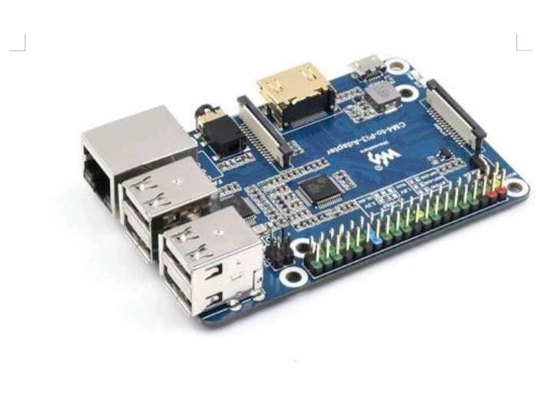
miCROCONTROLLER
The raspberry pi is an open-source micro-controller board based on the microchip ATmega328P microcontroller and developed by Arduino.cc.

Slide 19
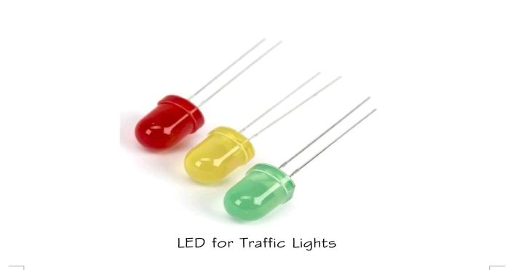
LED’s
LEDs are used for the purpose of signalling according to the traffic condition .

Slide 20
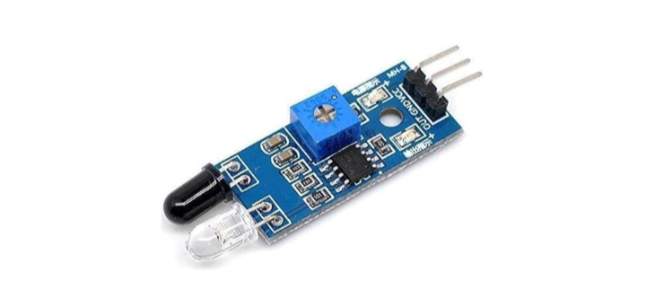
IR Sensor
IR Sensor is used to count the vehicles on the road.

Slide 21
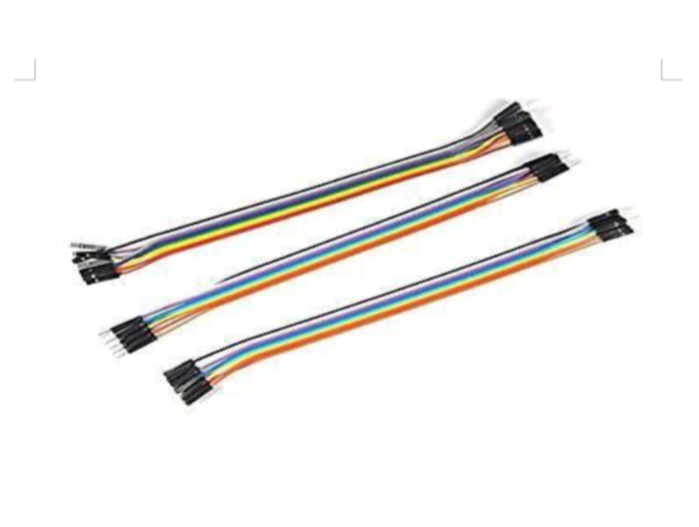
JUMBER WIRES
It is used connect the components to each other.

Slide 22
REQUIRMENTS SOFTWARE REQUIREMENT
Raspberry pi IDE : the raspberry pi integrated development environment(IDE) is a cross- platform application that is written in the programming language java.

Slide 23
PROTEUS DESIGN SUITE
The proteus design suite is a proprietary software tool suite used primarily for electronic design automation.
The software is used mainly by electronic design engineers prints for manufacturing printed circuit boards.

Slide 24
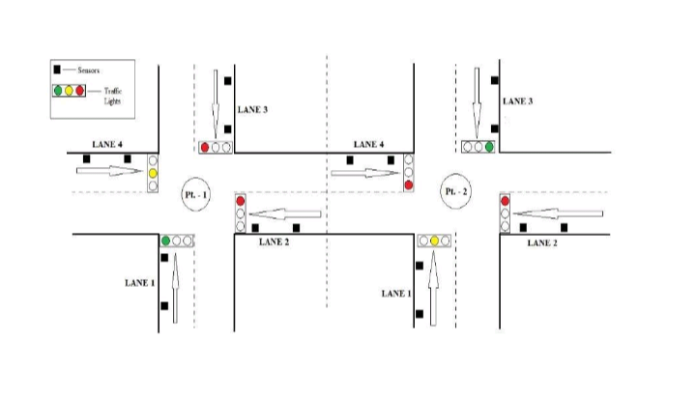
VIEW OF SIGNAL AT DIFFERENT LANES

Slide 25
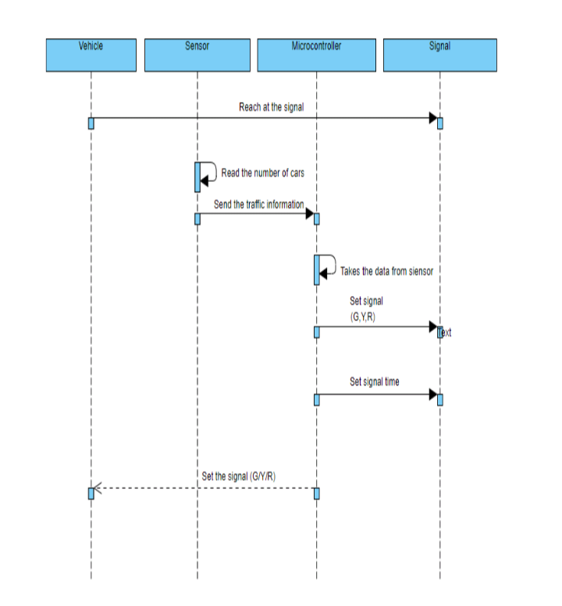

Slide 26
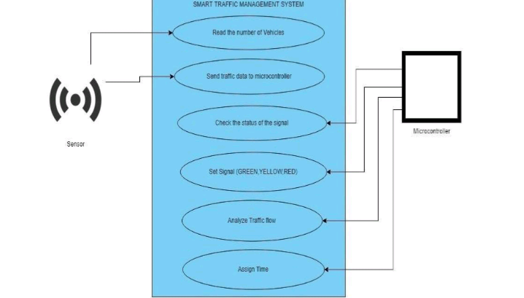
CASE DIAGRAM

Slide 27
COUNTER ALGORTHMS
Assuming the objects detected by the IR sensors to be vehicles , int counter = 0 ;
int hit object =
False;
int val;
Step 1 ;Read
Value from
Sensor.

Slide 28
Step 2: if val = = 0 hit object = false then increment the counter and set hit object
=true.
Else if val = = 1hit object =
true then set hit object =
False.

Slide 29
CONCLUSION
Traffic management system has been developed by using multiple features of hardware components in IOT.

Slide 30


